Slide 1
Data Warehousing
M R BRAHMAM

Slide 2
Data Warehousing - Architecture
Source Systems
ETL Layer
Data and Metadata Repository Layer
Presentation Layer
Execution
Systems
CRM
ERP
Legacy
e-Commerce
Extract, Transformation, and Load (ETL) Layer
Cleanse Data
Filter Records
Standardize Values
Decode Values
Apply Business Rules
Householding
Dedupe Records
Merge Records
Enterprise
Data
Warehouse
ODS
Reporting Tools
OLAP Tools
Ad Hoc Query Tools
Data Mining Tools
Data Mart
External
Data
Purchased Market Data
Spreadsheets
Metadata Repository
Data Mart
Data Mart
Custom Tools
HTML Reports
Cognos
Business Objects
MicroStrategy
Oracle Discoverer
Brio
Data Mining Tools
Portals
Sample Technologies:
PeopleSoft
SAP
Siebel
Oracle Applications
Manugistics
Custom Systems
ETL Tools:
Informatica PowerMart
ETI
Oracle Warehouse Builder
Custom programs
SQL scripts
Oracle
SQL Server
Teradata
DB2

Slide 3
OLTP vs DW
OLTP | DW
Data dependencies (E-R) model | Dimensional model
Microscopic data consistency | Global data consistency
Millions of transactions per day | One transaction per day
Mostly does not keep history | Keeping history is necessary
Gets loaded in the day | Gets loaded in the night

Slide 4
Dimensional Data Modeling
E-R model
  Symmetric
  Divides data into many entities
  Describes entities and relationships
  Seeks to eliminate data redundancy
  Good for high transaction performance
Dimensional model
  Asymmetric
  Divides data into dimensions and facts
  Describes dimensions and measures
  Encourages data redundancy
  Good for high query performance

Slide 5
Facts/Dimensions
Fact
  Central, dominant table
  Multi-part primary key
  Holds millions & billions of records
  Links directly to dimensions
  Stores business measures
  Constantly varying data

Slide 6
Facts/Dimensions (contd.)
Dimensions
  Single join to the fact table (single primary key)
  Stores business attributes
  Attributes are textual in nature
  Organized into hierarchies
  More or less constant data
  E.g. Time, Product, Customer, Store, etc.

Slide 7
Star/Snowflake schema
Star schema
  Fact surrounded by 4-15 dimensions
  Dimensions are de-normalized
Snowflake schema
  Star schema with secondary dimensions
  Don’t snowflake for saving space
  Snowflake if secondary dimensions have many attributes

Slide 8
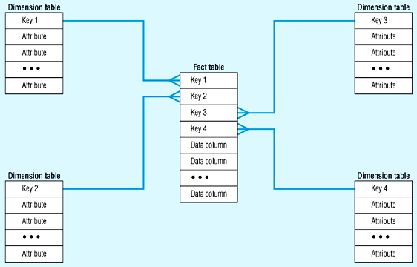
Star schema

Slide 9
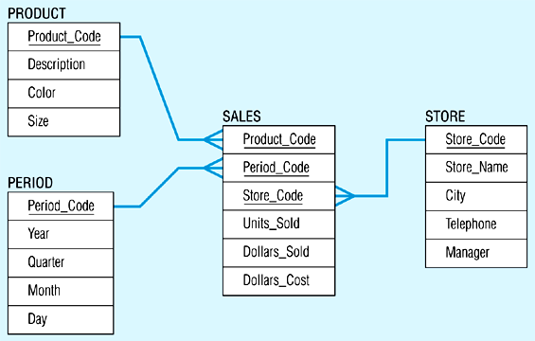
Star schema example

Slide 10
Snowflake schema example
Store Dimension
District_ID
Region_ID
STORE KEY
District Desc.
Region_ID
Region Desc.
Regional Mgr.
Store Description
City
State
District ID
District Desc.
Region_ID
Region Desc.
Regional Mgr.
Store Fact Table
STORE KEY
PRODUCT KEY
PERIOD KEY
Dollars
Units
Price

Slide 11
DM , DW & ODS
DM
  Organized around a single business process
  Represents small part of the organization’s business
  Logical subset of the complete data warehouse
  Faster roll out, but complex integration in the long run

Slide 12
DM , DW & ODS (contd.)
DW
  Union of its constituent data marts
  Queryable source of data in the organization
  Requires extensive business modeling (may take years to design and build)
ODS
  Point of integration for operational systems
  Low-level decision support
  Can store integrated data, but at detailed level

Slide 13
OLAP
Element of decision support systems (DSS)
Support (almost) ad-hoc querying for business analyst
Helps the knowledge worker (executive, manager, analyst) make faster & better decisions
ROLAP - extended RDBMS that maps operations on multidimensional data to standard relational operators
MOLAP - Special-purpose server that directly implements multidimensional data and operations

Slide 14
Others
Additive, semi-additive & non-additive facts
Factless facts
Slowly changing dimensions
Conformed facts and dimensions
Cubes
Drill down / Drill up
Slice and dice

